Slide 1

EVs
Group 4

Slide 2
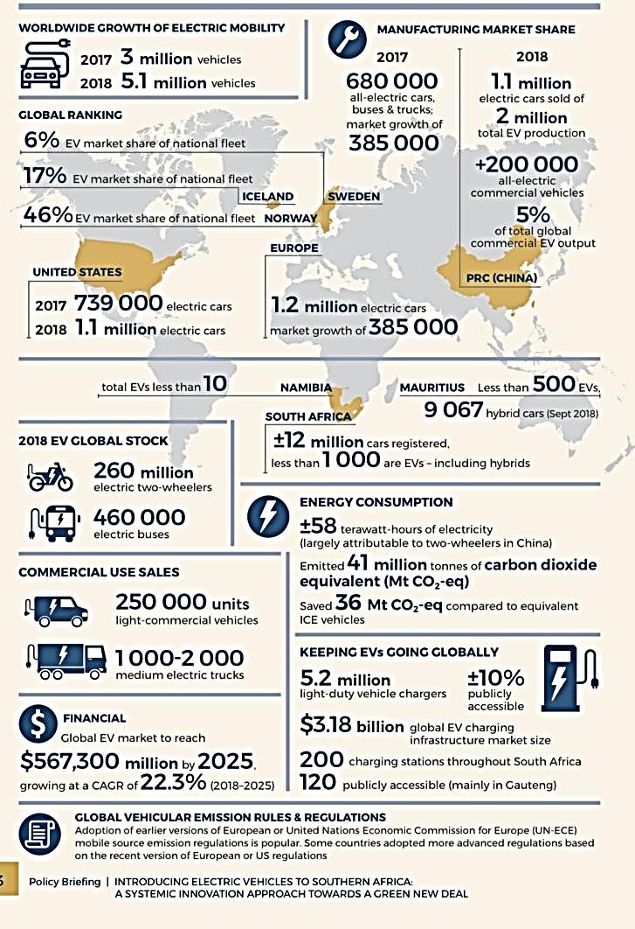
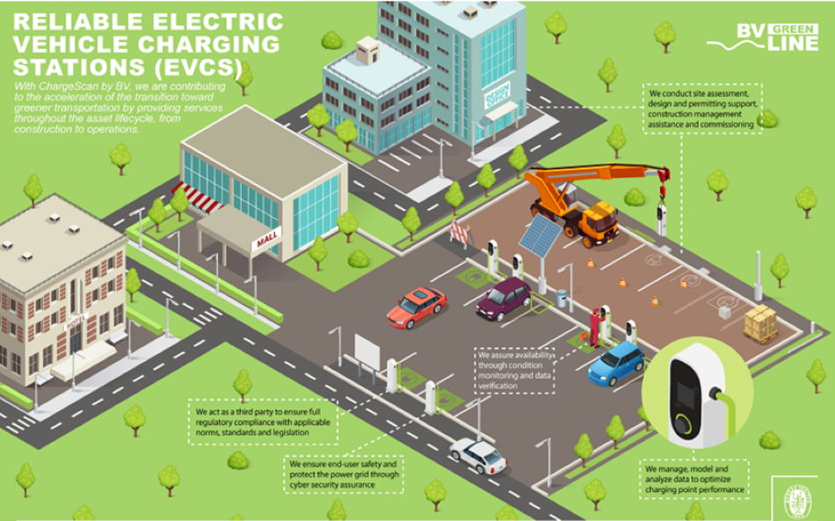
The Impact of Evs on the Automotive Sector Global Overview

Slide 3

Research Methodology
Before
Desk analysis
Bibliographic research
Metric – Critical Emissions Factor (CEF)
Life-cycle Analysis (LCA)
After
Adoption Rates: Number of EVs registered in the city.
Charging Station Usage: Frequency and duration of use of charging stations.
Public Satisfaction: Survey results from EV users and general public.
Environmental Impact: Reduction in emissions and improvement in air quality.

Slide 4
Evidence-based Policy Insights
Growing population and freight movements – 77% increase in transportation by 2055
By emitting very low or no emissions
Making very little noise
EVs reduce traffic congestion
Evs must become 50% of new vehicle sales by 2030 to achieve decarbonization goals
Sales of e-cars will be increased so it will need to meet this fraction of new vehicles sales

Slide 5
Benefits of EV Implementation
Environmental Benefits
Reduction in Greenhouse Gas Emissions: EVs produce zero tailpipe emissions, significantly reducing CO2 and other greenhouse gases compared to internal combustion engine vehicles (ICEVs).
Improved Air Quality: Lower emissions of pollutants such as NOx and particulate matter contribute to better urban air quality, which is beneficial for public health.
Economic Benefits
Lower Operational Costs: EVs generally have lower fuel and maintenance costs compared to ICEVs, offering long-term savings for both private owners and municipal fleets.
Job Creation: The growth of the EV market stimulates job creation in manufacturing, infrastructure development, and maintenance sectors.
Energy Benefits
Energy Efficiency: EVs convert over 77% of the electrical energy from the grid to power at the wheels, compared to about 12-30% for gasoline vehicles.
Renewable Integration: EVs can be charged using renewable energy sources, supporting the shift towards a more sustainable energy system.

Slide 6
Challenges of EV Implementation
Infrastructure Development
Charging Stations: Establishing a comprehensive network of accessible and fast-charging stations is crucial for widespread EV adoption.
Grid Capacity: Upgrading the electrical grid to handle increased demand from EV charging is necessary to avoid overloading and ensure reliability.
Economic Barriers
High Initial Costs: The upfront cost of EVs can be a barrier for consumers, despite lower lifetime costs. Incentives and subsidies are essential to offset these costs.
Battery Costs: The cost of EV batteries remains high, impacting vehicle prices and making battery management and recycling critical components of the implementation strategy.
Consumer Acceptance
Range Anxiety: Consumers may be concerned about the limited range of EVs and the availability of charging infrastructure, which can hinder adoption.
Awareness and Education: Increasing public awareness and understanding of EV benefits and functionalities is important for encouraging adoption.

Slide 7
Evidence and Case Studies
City of Oslo, Norway
Policy Support: Oslo has implemented strong policy measures including tax exemptions, free parking, and access to bus lanes for EVs, leading to a significant increase in EV adoption.
Charging Infrastructure: The city has developed an extensive network of public charging stations, ensuring accessibility for EV owners.
Shenzhen, China
Electric Public Transport: Shenzhen has fully electrified its public bus fleet, resulting in substantial reductions in air pollution and operational costs.
Government Initiatives: The Chinese government has provided substantial subsidies and incentives to support EV manufacturing and adoption.
San Francisco, USA
Public-Private Partnerships: Collaboration between the city government and private companies has led to the development of a robust EV charging infrastructure.
Fleet Electrification: The city has initiated programs to electrify municipal fleets, including buses and service vehicles, promoting sustainability.

Slide 8
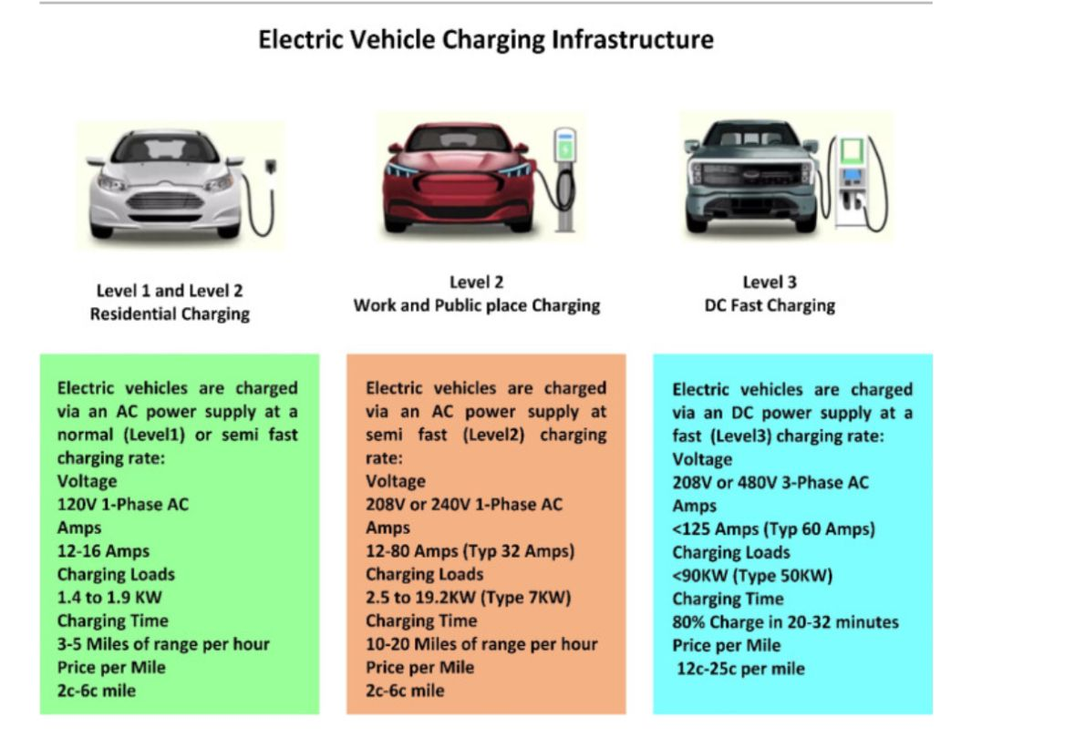

Slide 9


